Slide 1

Stock Market Visualization and Analysis
Moukhik Misra

Slide 2
Procedure
Section I: Analysis and Prediction of 1 random stock from the dataset
Section II: Market Indicator analysis of selected stock and 3 random stocks from the dataset
Importing the dataset and selecting random stock
Company Summary
Basic Plot of Closing Price
Plot of Volume of stock
Lag Plot (Correlation plot between y(t) and y(t+5))
Segregation of Train and Test Data
Prediction using Auto Regressive Integrated Moving Average (ARIMA)
Calculating Mean Square Error (MSE) and Symmetric Mean Absolute Percentage Error (SMAPE).
Importing 3 more random stocks
Relative Strength Index (RSI)
Bollinger Bands
Aroon Oscillator
Moving Average Convergence Divergence(MACD)
Kaufman’s Adaptive Moving Average
Money Flow Index
Williams %R
Volumetric Analysis

Slide 3
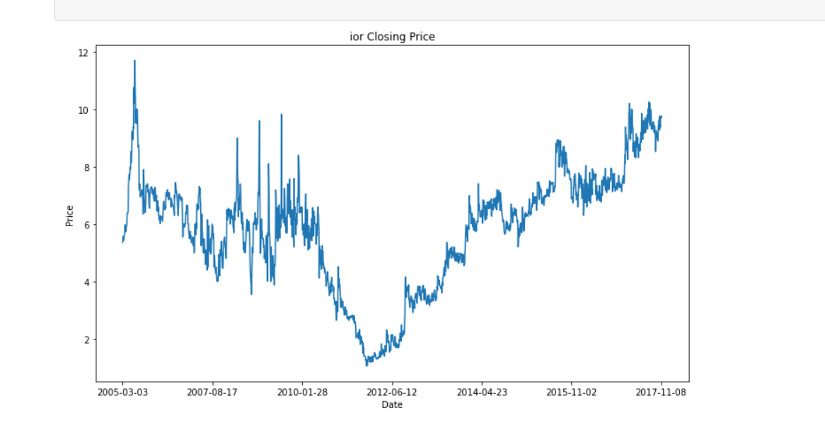
Section I: Basic Plot of closing price
Plotting the closing price of the stock selected with respect to Date.

Slide 4
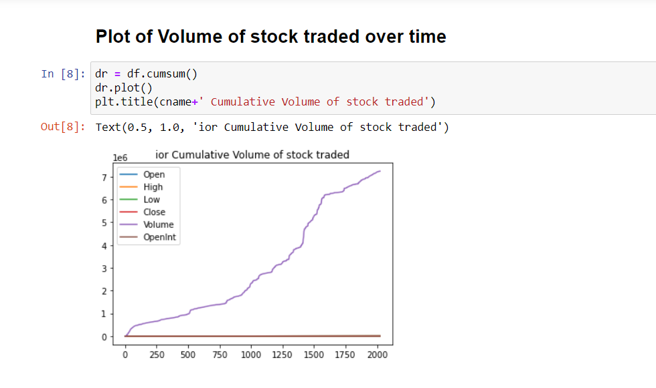
Volume of stock traded over time

Slide 5
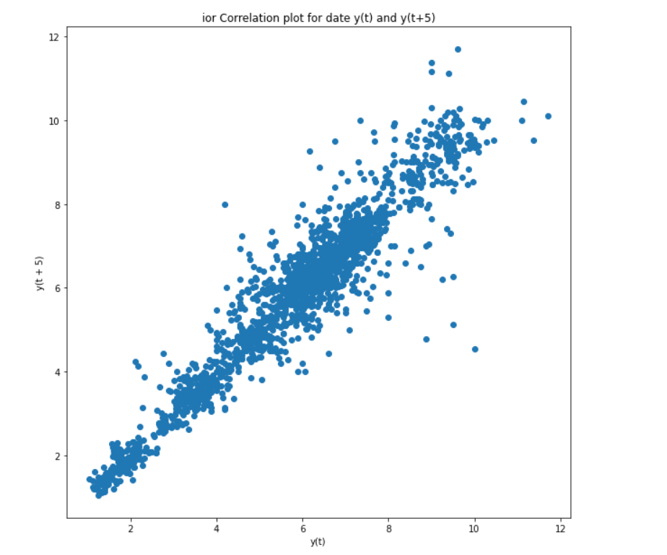
Lag plot
The lag plot plots the observation at time t on the x-axis and the lag 5 observation (t+5) on the y-axis. If the points cluster along a diagonal line from the bottom-left to the top-right of the plot, it suggests a positive correlation relationship.
A lag plot suggesting a positive correlation in stock implies low volatility and a consistent trend.

Slide 6
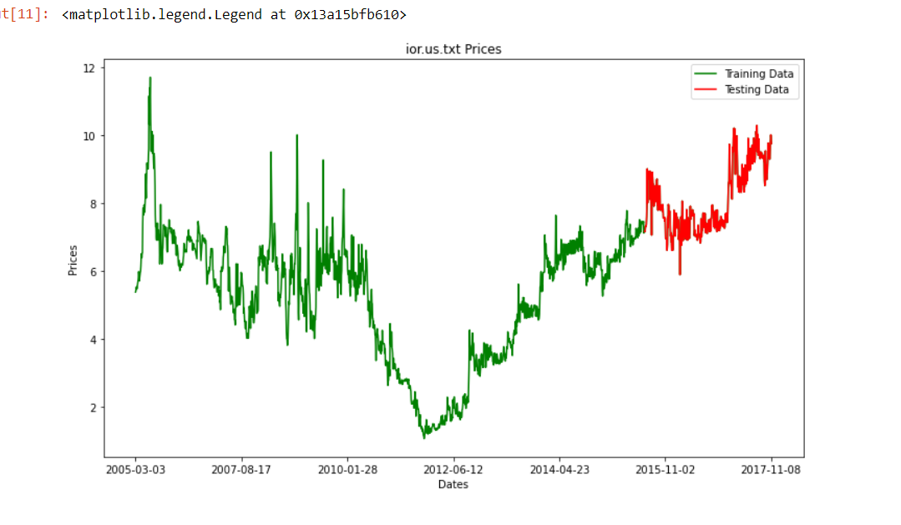
Segregation of train and test data
The dataset has been divided as 80% for train data and 20% for testing data
The segregation has been plotted and represented with different colours.

Slide 7
Prediction using Auto Regressive Integrated Moving Average (ARIMA)
ARIMA, short for ‘Auto Regressive Integrated Moving Average’ is actually a class of models that ‘explains’ a given time series based on its own past values, that is, its own lags and the lagged forecast errors, so that equation can be used to forecast future values.
An ARIMA model is characterized by 3 terms: p, d, q where,
p is the order of the Auto Regressive term,
q is the order of the Moving Average term,
d is the number of differencing required to make the time series stationary.

Slide 8
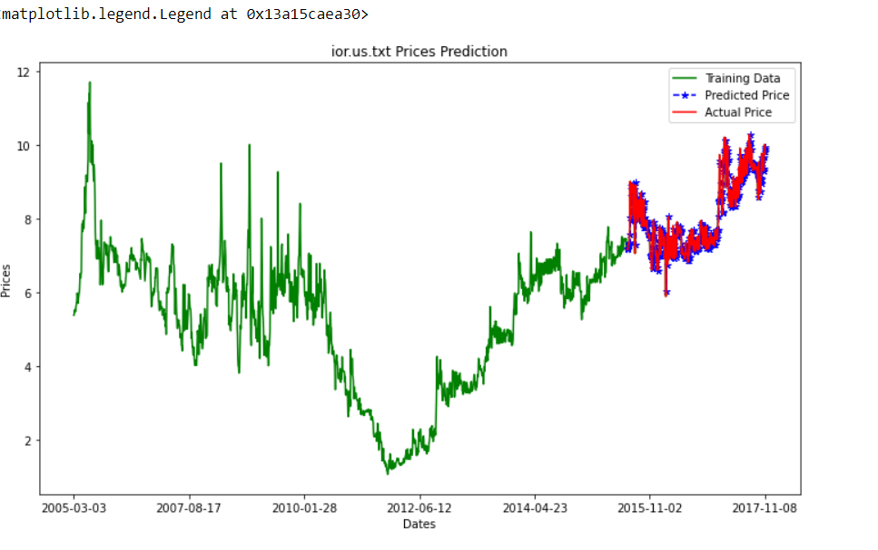
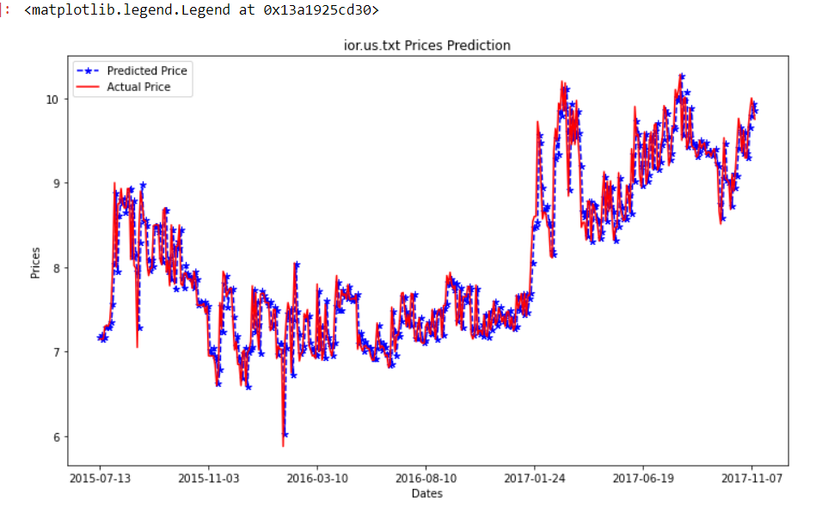
ARIMA Predictions

Slide 9
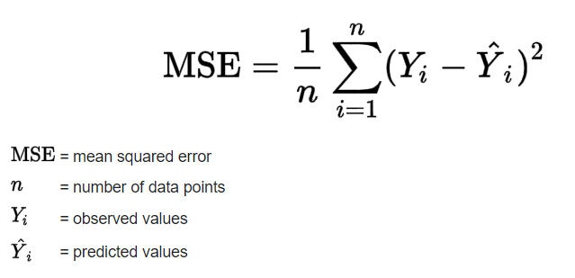
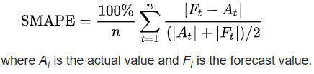

MSE and SMAPE
MSE : The mean squared error (MSE) tells you how close a regression line is to a set of points. It does this by taking the distances from the points to the regression line (these distances are the “errors”) and squaring them. The squaring is necessary to remove any negative signs. It also gives more weight to larger differences. It’s called the mean squared error as you’re finding the average of a set of errors. The lower the MSE, the better the forecast.
SMAPE: Symmetric mean absolute percentage error (SMAPE or sMAPE) is an accuracy measure based on percentage (or relative) errors.

Slide 10
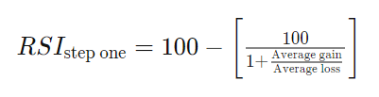

Section ii: relative strength index (RSI)
The relative strength index (RSI) is a momentum indicator used in technical analysis that measures the magnitude of recent price changes to evaluate overbought or oversold conditions in the price of a stock or other asset. The RSI is displayed as an oscillator (a line graph that moves between two extremes) and can have a reading from 0 to 100.
An asset is usually considered overbought when the RSI is above 70% and oversold when it is below 30%.

Slide 11
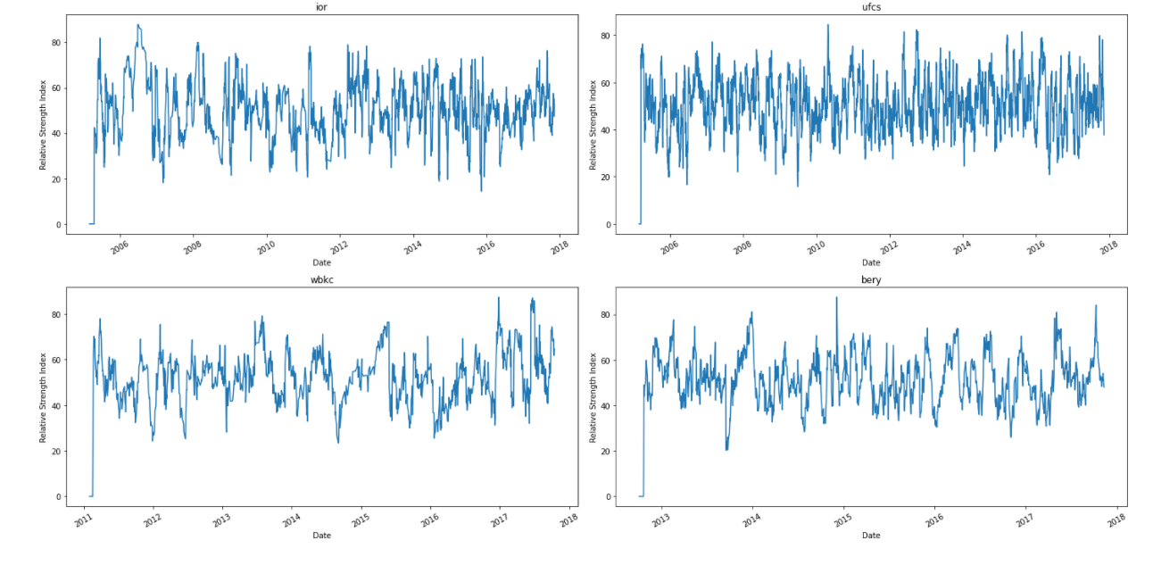
Relative strength index (RSI)

Slide 12
Bollinger Bands
BOLU=MA(TP,n)+m∗σ[TP,n]
BOLD=MA(TP,n)−m∗σ[TP,n]
where:
BOLU=Upper Bollinger Band
BOLD=Lower Bollinger Band
MA=Moving average
TP (typical price)=(High+Low+Close)÷3
n=Number of days in smoothing period (typically 20)
m=Number of standard deviations (typically 2)
σ[TP,n]=Standard Deviation over last n periods of TP
​
A Bollinger Band is a technical analysis tool defined by a set of trend lines plotted two standard deviations (positively and negatively) away from a simple moving average (SMA) of a security's price.
The closer the prices move to the upper band, the more overbought the market, and the closer the prices move to the lower band, the more oversold the market.

Slide 13
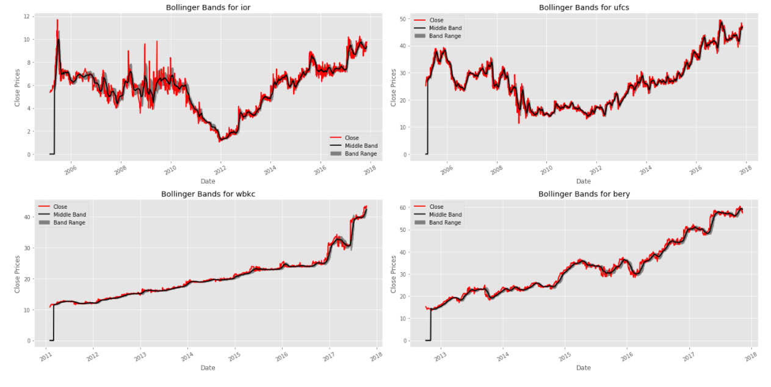
Bollinger bands

Slide 14
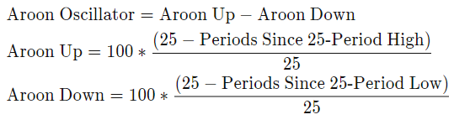
Aroon oscillator
The Aroon Oscillator is a trend-following indicator that uses aspects of the Aroon Indicator (Aroon Up and Aroon Down) to gauge the strength of a current trend and the likelihood that it will continue.
Readings above zero indicate that an uptrend is present, while readings below zero indicate that a downtrend is present.
Above 50 or below -50 signal strong price moves.

Slide 15
Moving Average Convergence Divergence(MACD) & Kaufman’s Adaptive Moving Average
Moving average convergence divergence (MACD) is a trend-following momentum indicator that shows the relationship between two moving averages of a security’s price.
The MACD is calculated by subtracting the 26-period exponential moving average (EMA) from the 12-period EMA.
Kaufman's Adaptive Moving Average (KAMA) is a moving average designed to account for market noise or volatility.
KAMA will closely follow prices when the price swings are relatively small and the noise is low.
KAMA will adjust when the price swings widen and follow prices from a greater distance.
This trend-following indicator can be used to identify the overall trend, time turning points and filter price movements.

Slide 16
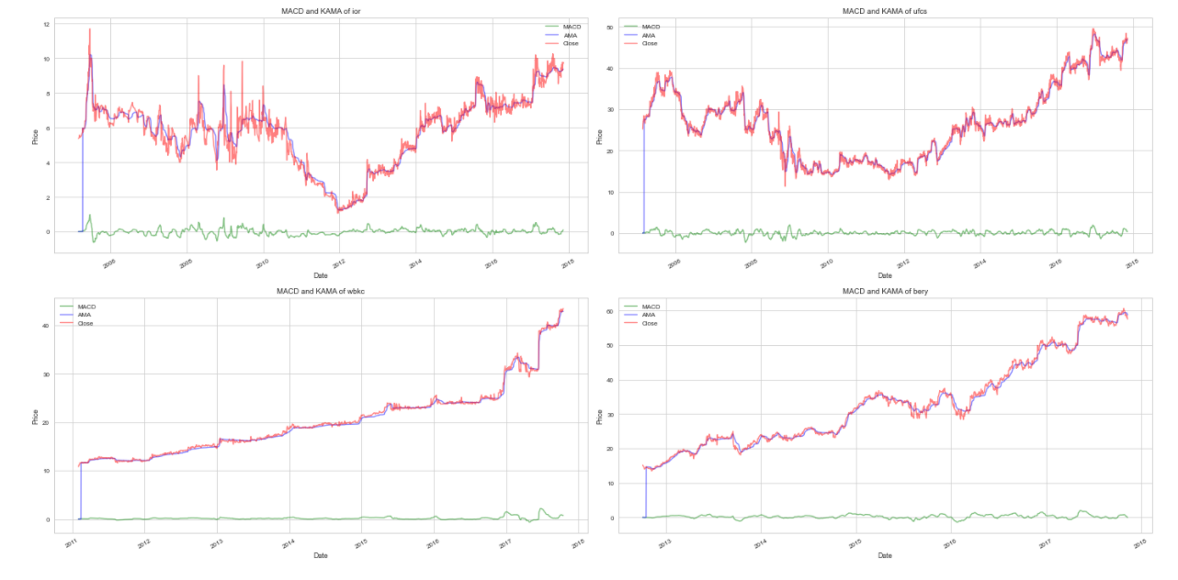
Moving Average Convergence Divergence(MACD) & Kaufman’s Adaptive Moving Average
MACD=12-Period EMA − 26-Period EMA
ER = Change/volatility
Change = Absolute Value [Close – Close (past 10 periods)]
Volatility Sum = 10 periods (Close – Prior Close)
SC= [ER x (Fastest SC – Slowest SC) + Slowest SC]^2
KAMA_{i} = KAMA_{i-1} + SC x (Price

Slide 17
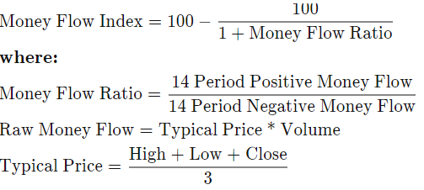
Money flow index
The Money Flow Index (MFI) is a technical oscillator that uses price and volume data for identifying overbought or oversold signals in an asset.
It can also be used to spot divergences which warn of a trend change in price. The oscillator moves between 0 and 100.

Slide 18
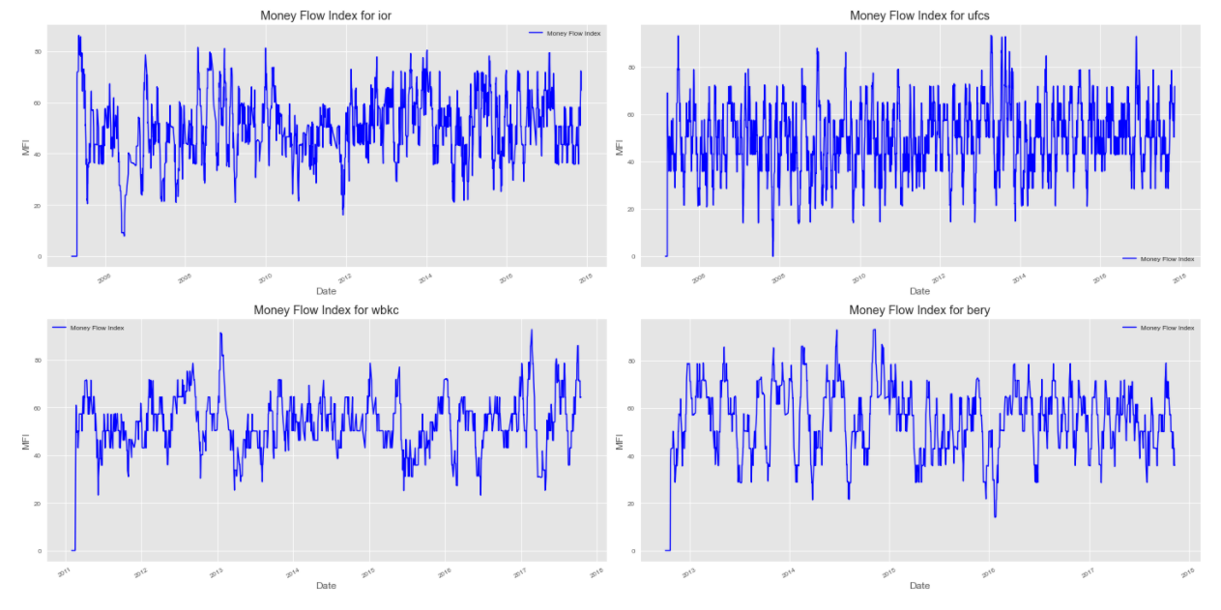
Money flow index

Slide 19
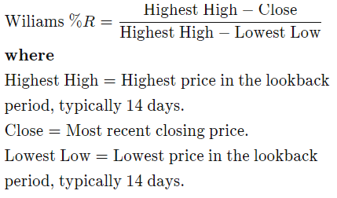
Williams %r
Williams %R, also known as the Williams Percent Range, is a type of momentum indicator that moves between 0 and -100 and measures overbought and oversold levels.
The Williams %R may be used to find entry and exit points in the market.
Williams %R moves between zero and -100. A reading above -20 is overbought. A reading below -80 is oversold.

Slide 20
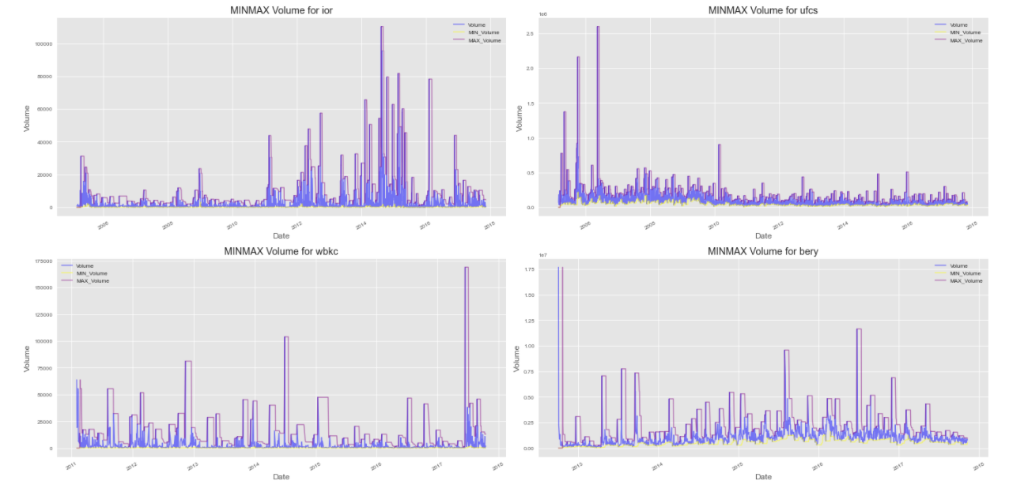
Volumetric analysis
Gives a representation of the volume of stock trades as well as rolling minimum and maximum volume of stock traded over a defined period.

